Slide 1

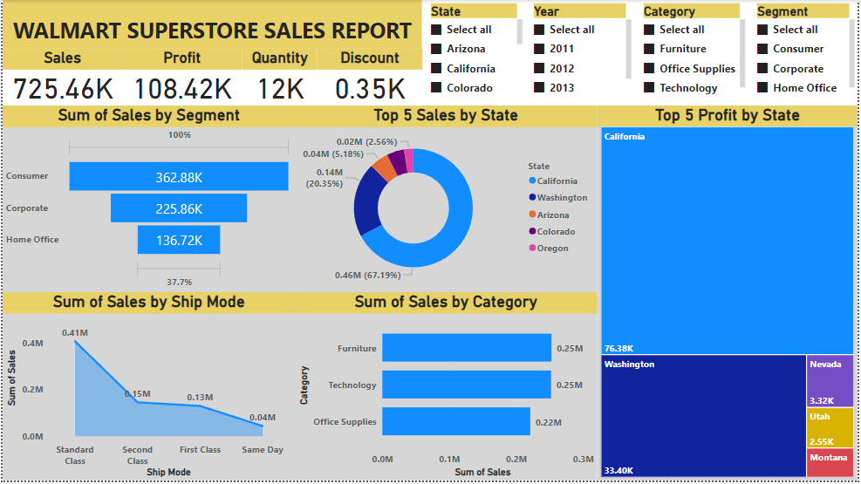
SUMMARY:
Designed Interactive dashboard with a given data using PowerBI visualisation tool and also used some Main Components of Segment wise sales, Ship Mode Analysis, Category wise Sales & Top states data are performed.

Slide 2
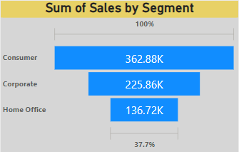
INSIGHTS 1:
As per the analysis of the given data Consumer is the top of the Segment with the 362.88K sales of Walmart & followed by the other segments.

Slide 3
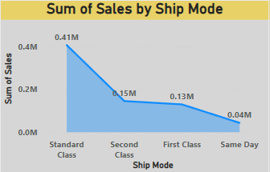
INSIGHTS 2:
As per the analysis of the given data Standard Class is the top of the Ship Modes with the 0.41M Customers of Walmart & followed by the other Ship Modes.

Slide 4
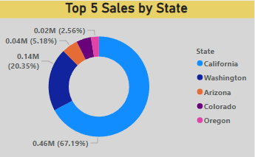
INSIGHTS 3:
As per the State wise sales Analysis the Most Sales happened in California when compared to all other states. Even though Oregon has least number of sales they fall under top 5 sales by State.

Slide 5
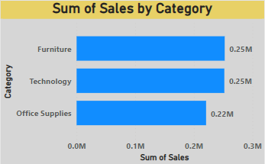
INSIGHTS 4:
As per the analysis both Furniture and Technology has the top most Category wise Sales when compared to office Supplies. Office Supplies are the least Sales in the Category wise Sales data.

Slide 6
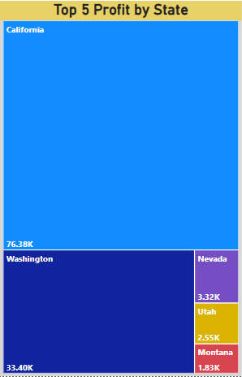
INSIGHTS 5:
As per the analysis the California, Washington, Nevada, Utah and Montana are the top 5 states where the Profit are high in number.

Slide 7

KPI:
As per the data we have 11 states with the total Sales of 725.46K and also maximum profit 108.42K earned by the Walmart from (2011-2014).
CONCLUSION:
Overall data explains that the Walmart sales increasing year by year (2011-2014) and there is no downfall of customers. The most sales & profit happened in California.

